Slide 1
Data analysis from the lens of marketing analytics
Visualizations, scenarios, and more
By Vishal Vatnani

Slide 2

About me
Current role: Marketing Analyst @ Instacart
Here to talk about my experience working as an analyst for 3.5 years
Education: Bachelors in IT Engineering, Masters in Information Systems
Previous roles: Data Analyst, Growth Marketing Analyst, Growth Analyst
Interests: Funnel optimization, A/B testing, performance & growth marketing, ETL, data modeling, dashboards, machine learning, user research
Vishal Vatnani

Slide 3
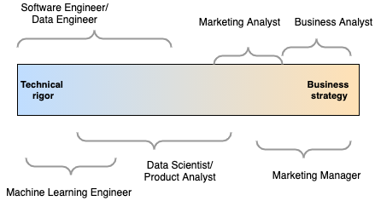
Who is a marketing analyst?
Relevant for mid-size to large organizations
Smaller organizations or startups may typically have a single data analyst role spanning across functions
Heavy focus on technical rigor in early-stage startups to build environments, set up models, etc.
As organizations scale, specialized work becomes more relevant

Slide 4
Responsibilities of a Marketing Analyst
Facilitate marketing spend decisions
Provide campaign recommendations
A/B testing
Data deep-dives
Ideate, prioritize, and execute growth tactics
Opportunity sizing for marketing/product initiatives
Root cause analysis into the changes in traffic, revenue, audience mix, etc.
Create self-serve dashboards and visualizations
Understand and own marketing KPIs and/or Product areas
Segmentation, forecasting, modeling

Slide 5
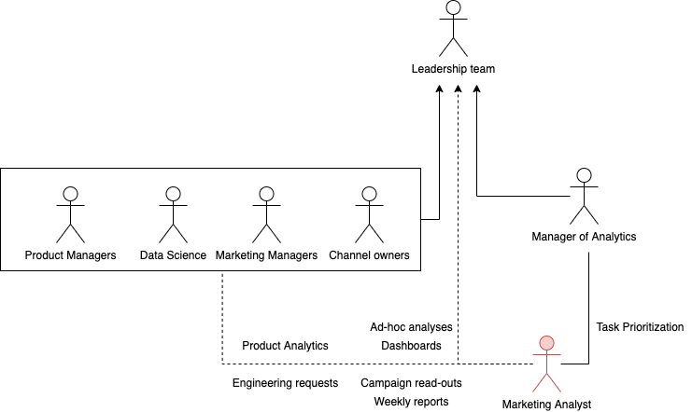
The Marketing Analyst role in a typical org
RCA

Slide 6
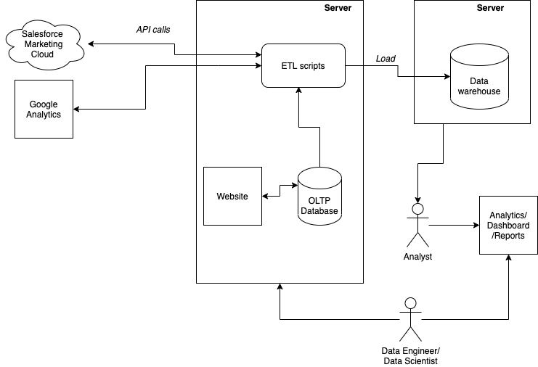
Where do the analysts get data from?

Slide 7





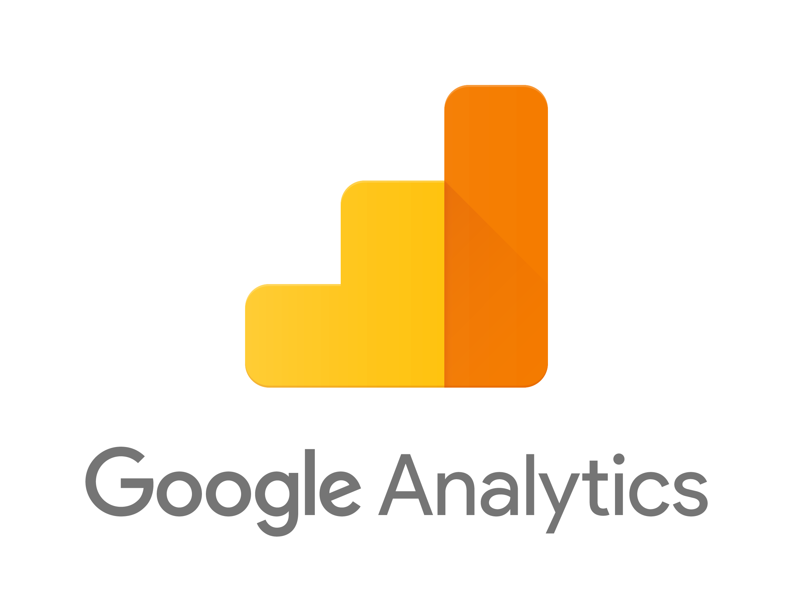



Marketing Analytics toolkit
Database language (SQL, NoSQL: MongoDB)
Mostly OLAP queries
Data visualization and BI (Excel, Tableau, Power BI)
Programming language (Python, R)
Web analytics (Google Analytics, Amplitude, Adobe Analytics)
Ads platform (Google Ads, Facebook Ads)
Experimentation platforms (Optimizely, LeadPages)
Customer Relationship Management platform (Mailchimp, Salesforce - ExactTarget)
Version control and project management (GitHub, Jira)

Slide 8
Responsibilities of a Marketing Analyst
Facilitate marketing spend decisions
Provide campaign recommendations
A/B testing
Data deep-dives
Ideate, prioritize, and execute growth tactics
Opportunity sizing for marketing/product initiatives
Root cause analysis into the changes in traffic, revenue, audience mix, etc.
Create self-serve dashboards and visualizations
Understand and own marketing KPIs and/or Product areas
Segmentation, forecasting, modeling

Slide 9
Categories of visualizations
Three broad categories:
Exploratory - emphasis on insights, speed, scale
Explanatory – emphasis on readability, simplicity, design principles, story-telling
Self-serve dashboards - extends exploratory and explanatory visuals

Slide 10
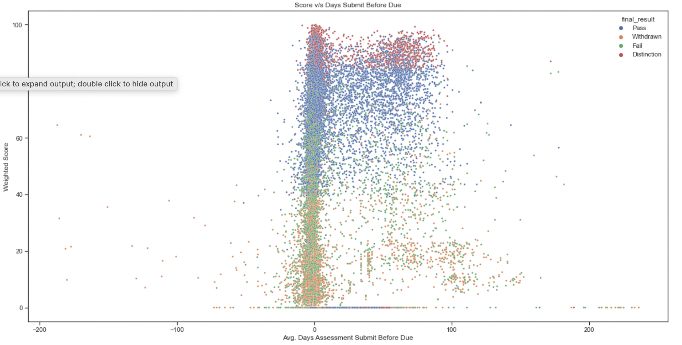
Exploratory Visualizations

Slide 11
Purpose of exploratory visualizations
Used to summarize the data in a visual way
Helps spot trends quickly that are otherwise missed in text format
Helps better understand distribution of variables, correlation among variables, missing values, outliers, etc.

Slide 12
Components of explanatory visuals (EDA)
Uni-variate analysis
Histogram, Distribution plot (density, cumulative distribution), Box plot
Bi-variate analysis
Scatterplot, stacked bar plot
Multivariate analysis
Multiple scatter plots (pair plot)
Notes:
Distribution plot approximates the underlying density function. Another way of looking at histogram to smooth the data

Slide 13
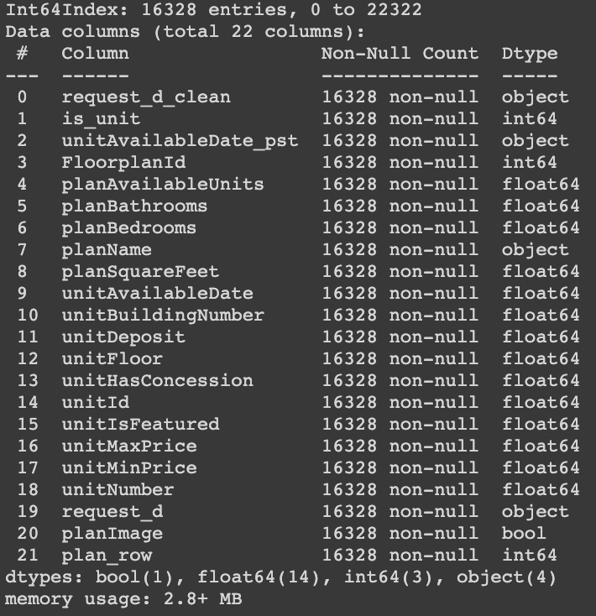

EDA walkthrough
https://colab.research.google.com/drive/12vM1hMAiCpggmOLZgOLaZ3Pq3VlQIPDM?usp=sharing
Dataset
Scraped from
Brookfield Properties

Slide 14
How I collected the data
Date range: 08-02-2020 – 02-10-2021
https://github.com/vishalvsparrow/rent-scraper

Slide 15
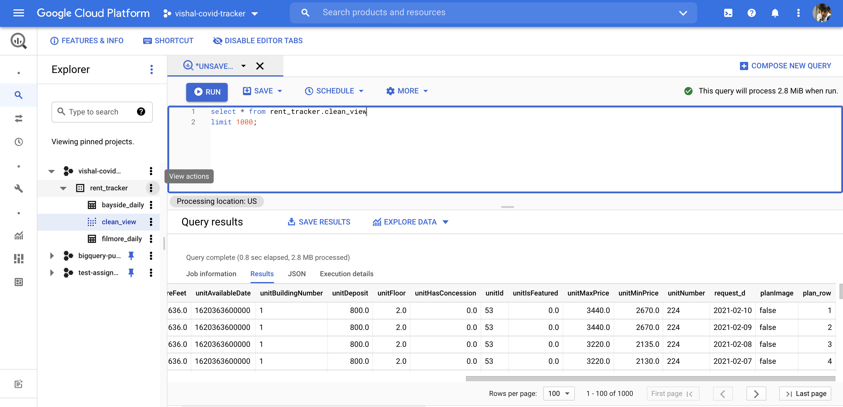
End result

Slide 16
Explanatory Visualizations

Slide 17
Purpose of explanatory visualizations
Commonly used when insights already synthesized from analysis
Mainly to solicit an action or spread awareness
For presenting to key stakeholders or sharing results with broader audience
Manifest as ad-hoc, less frequently updated charts

Slide 18
Steps in explanatory visualizations
Often an iterative process
Followed by an analysis, after gathering the insights:
Understand the business context and talk to stakeholders (scope of the analysis, notable events)
Consideration for nuances in the data (NULL values, outliers, scale, EDA)
Decide on the right grain and grouping of data (aggregate v/s individual data-point, summary by channel)
Choose the simplest and richest chart
De-clutter the chart
Draw attention to the notable parts of the chart
Formulate an actionable one-liner for the title
Tell a story

Slide 19
Visualization Scenario 1 (Line charts)
At a membership-based retail business, a marketing manager has given you the task to see if there is any difference in revenue from customers who order through the promotional membership v/s at regular membership over the last year for a retail business
Understand the business context and talk to stakeholders
Upon talking to the manager, you find out that they are interested in longitudinally studying the purchase behavior of customers over a period of last 12 months
So, your customer base is anybody who purchased through promo v/s regular price in the last 12 months
Consideration for nuances in the data (NULL values, outliers, scale, EDA)
You do the usual sanity checks – de-duping, removing transactions with data issues, such as sale price > any single item in the product portfolio, etc.
Decide on the right grain and grouping of data (aggregate v/s individual data-point, summary by channel)
You decide showing the total revenue makes more sense than average revenue per customer given the context
Choose the simplest and richest chart
You decide a line chart works the best
De-clutter the chart – next slides
Draw attention to the notable parts of the chart – next slides
Formulate an actionable one-liner for the title – next slides
Tell a story
You find some big drops in revenue on some days, and you go back to the manager who tells you about some notable events

Slide 20
Revenue from 10/4/20 to 8/8/21

Slide 21
Promo revenue is consistently lower than the regular revenue for the October cohort
Price increase in the week of 12/6
Discounts given to promo customers
Issue with marketing emails during the week of 5/16

Slide 22
Promo revenue is consistently lower than the regular revenue for the October cohort
Added actionable title
Annotations explain dips and spikes
Price increase in the week of 12/6
Discounts given to promo customers
Y-Axis labels formatted
Issue with marketing emails during the week of 5/16
Legend removed and used series name as labels
X-Axis labels reflect cohort age
Notes:
Story: Regular revenue was around $1.5M, or 18% higher than the Promo revenue at the beginning of October. But due to various issues, the promo revenue dropped to almost half of regular revenue at the end of 45 weeks. The steep drop in promo member revenue after the issue with marketing email may suggest that promo customers are more likely to order if touched regularly with emails. Next steps: a) look at more recent cohorts, b) check the email unsubscription rates, c) check website visits, d) check avg. order size, e) test if more emails drive more revenue from promo customers

Slide 23
Visualization Scenario 2 (Horizontal Line Chart)
At a sunglass business, you are interested in finding out how customer preferences have shifted year-over-year between Regular, Blue light, and Polaroid glasses
2019 to 2020 | Polaroid | Blue light | Regular
Polaroid | 70% | 10% | 20%
Blue light | 37% | 55% | 8%
Regular | 30% | 40% | 30%
2020 to 2021 | Polaroid | Blue light | Regular
Polaroid | 17% | 49% | 34%
Blue light | 40% | 46% | 14%
Regular | 15% | 50% | 35%

Slide 24
The Polaroid segment sees a strong shift in preference to Blue light glasses in 2021

Slide 25
The Polaroid segment sees a strong shift in preference to Blue light glasses in 2021

Slide 26
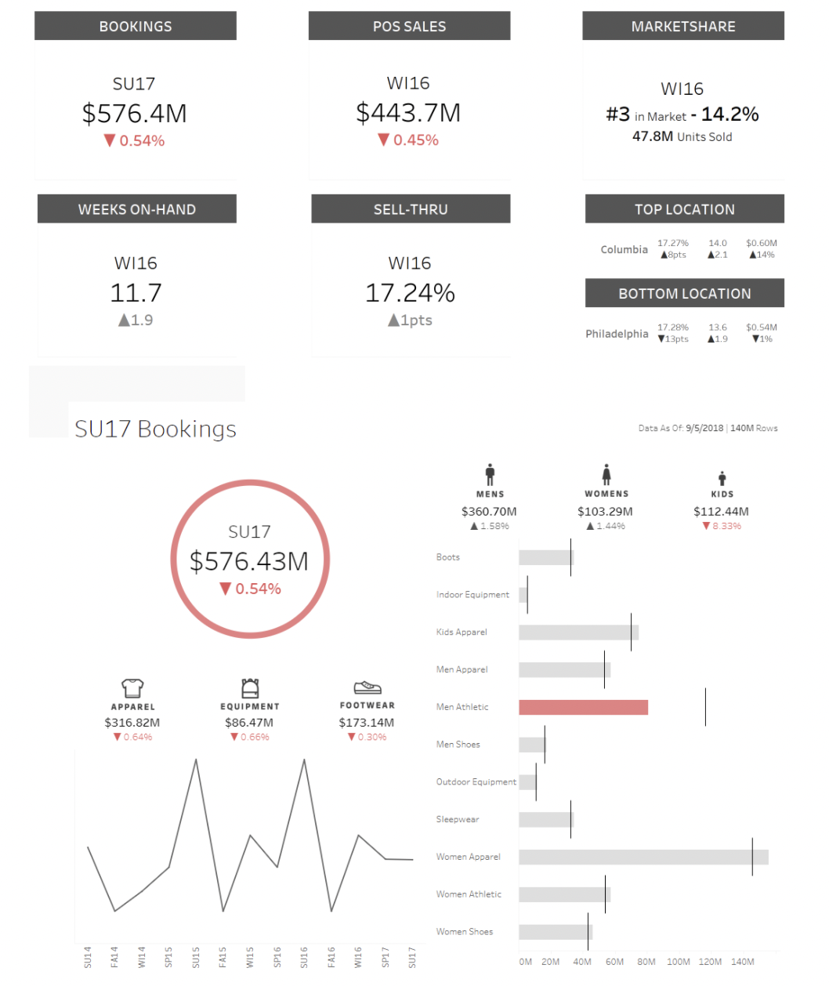
Self-serve dashboard (best practices)
https://www.justinmind.com/blog/dashboard-design-best-practices-ux-ui/
https://mode.com/example-gallery/
Build considerations:
Query execution time
Grain of data to load
Calculation in Tableau v/s Pre-calculated metrics
Query execution frequency
Extract v/s Live refresh
Components:
Score card with high level KPIs
Week over Week or Month over Month view
KPI trends
Source: https://interworks.com/blog/jlyons/2018/09/14/creating-a-scorecard-in-portals-for-tableau/

Slide 27
A/B testing (Two-group experimental design)

Slide 28
Steps in setting up an A/B test
Formulate the hypothesis and the expected learnings
Set a primary KPI and secondary KPIs to optimize
Create a test charter where various scenarios and outcomes are described
What happens if we see that our conversion in the Control group is performing 10% less than the benchmark?
Decide on the audience, criteria, and the channel(s) for a randomized list pull and group assignment
Set the statistical significance threshold, power, and sample size
Launch the experiment
Read on the experiment
Avoid p-value hacking, peeking, etc.
Test for lift, effect size, significance
Present learnings, formulate a rollout plan if success, next steps if failure

Slide 29
List-pull example
https://colab.research.google.com/drive/12vM1hMAiCpggmOLZgOLaZ3Pq3VlQIPDM#scrollTo=lt0izjA5gC2W

Slide 30
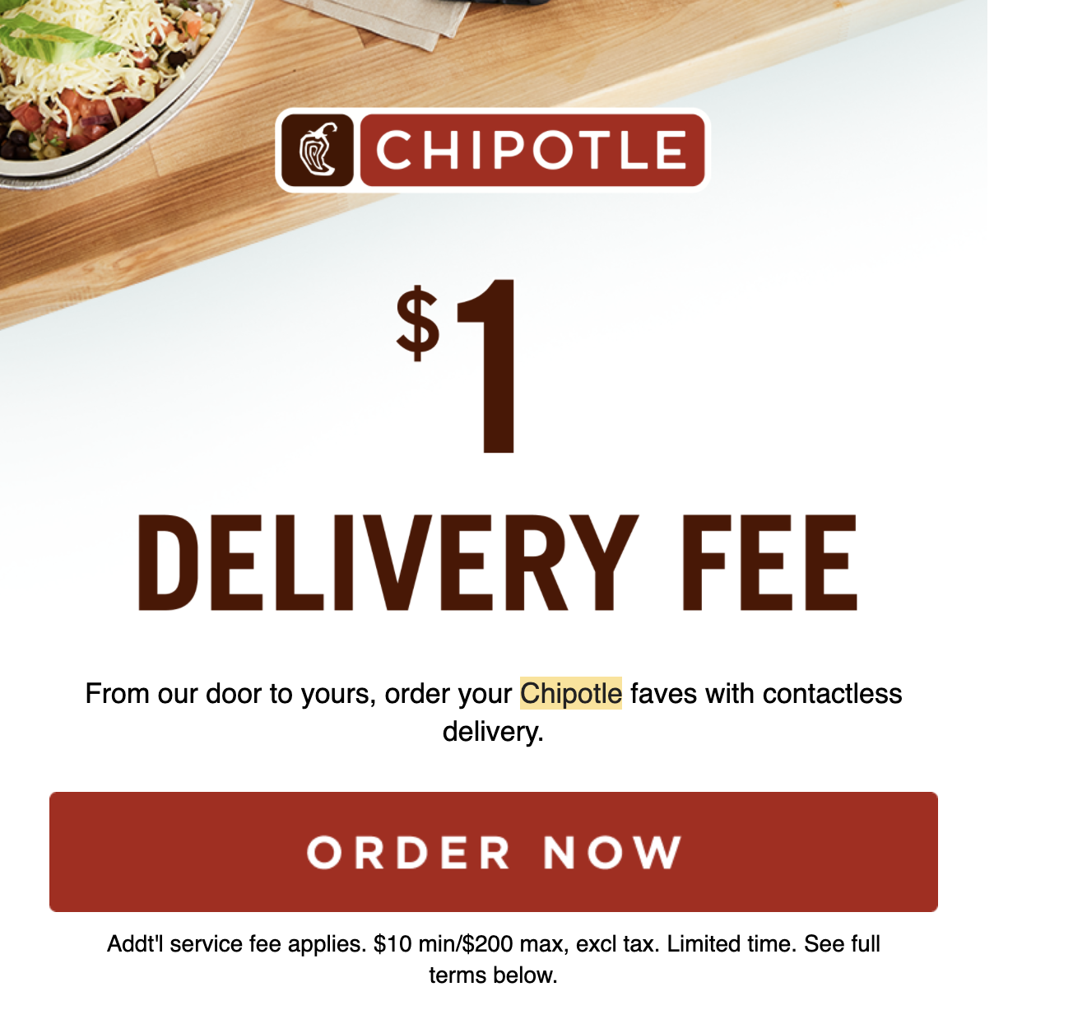

A/B Testing Scenario
Results of an AB test on email
Variant – A: $1 delivery incentive
Variant – B: $0 delivery incentive

